Slide 1




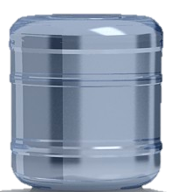
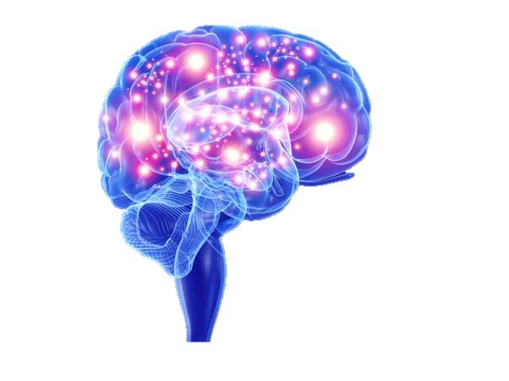
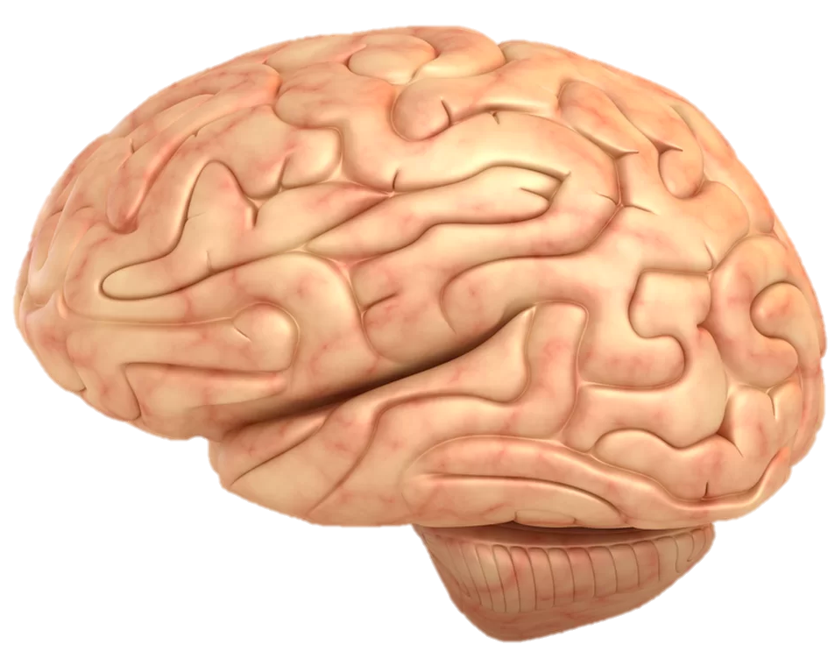
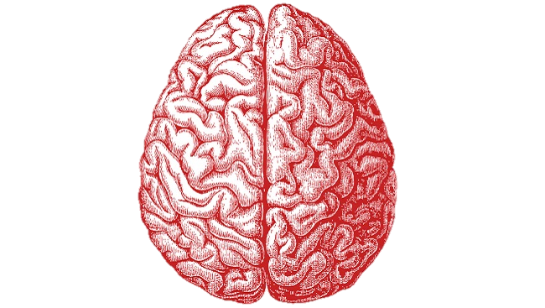

Slide 3




Slide 5
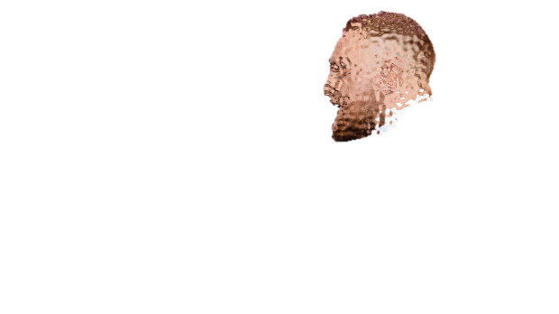
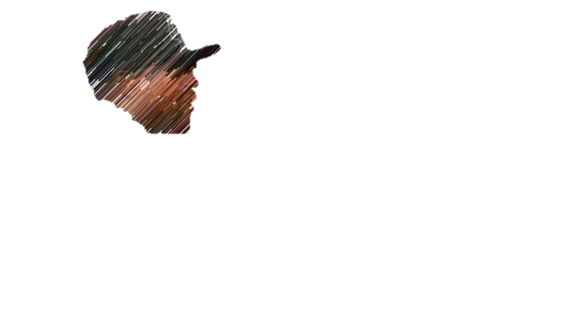

Slide 6
Buster Baxter (voiced by Daniel Brochu) is Arthur’'s best friend. He is a white rabbit who wears a turquoise long-sleeve shirt and dark jeans. He suffers from asthma.
Byron "Buster" Bluth (played by Tony Hale) is the youngest son of George Sr. and Lucille. He has frequent panic attacks, hates both closed and open spaces, is terrified of sheep, seals, and birds,

Slide 7

Points!

